Slide 1

MAT203: Linear Algebra
In Ryu
September 1, 2016

Slide 2
Systems: Modeling and Solving
Modeling: Real Systems ➔ Abstract Models

Slide 3
Systems: Modeling and Solving
Modeling: Real Systems ➔ Abstract Models

Slide 4
Systems: Modeling and Solving
Modeling: Real Systems ➔ Abstract Models

Slide 5
Systems: Modeling and Solving
Modeling: Real Systems ➔ Abstract Models

Slide 6
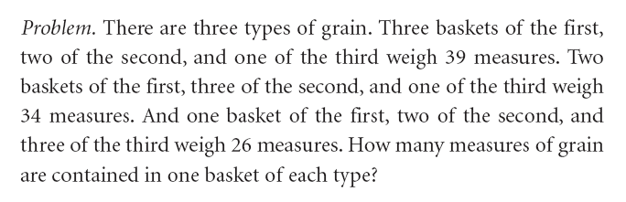
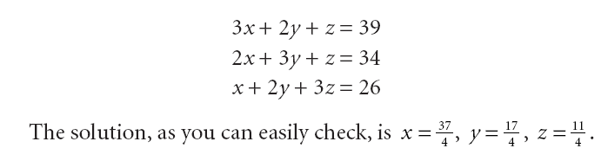
Systems: Modeling and Solving
Modeling: Real Systems ➔ Abstract Models

Slide 7
Systems: Modeling and Solving
Modeling Error:
Right (Effective) Model or Not : Systems of Linear Equations
Accuracy in Parameterization (Estimation of Parameters)
Representation of Parameters in Computers / Papers

Slide 8
Systems: Modeling and Solving
Solving: Abstract Models ➔ Find Unknowns
By Hand or using Computers
Using your own programs or Somebody else’s programs
Accuracy in Solving ?
Efficiency in Solving ?

Slide 9
Systems of Linear Equations
Systems of Linear Equations

Slide 10
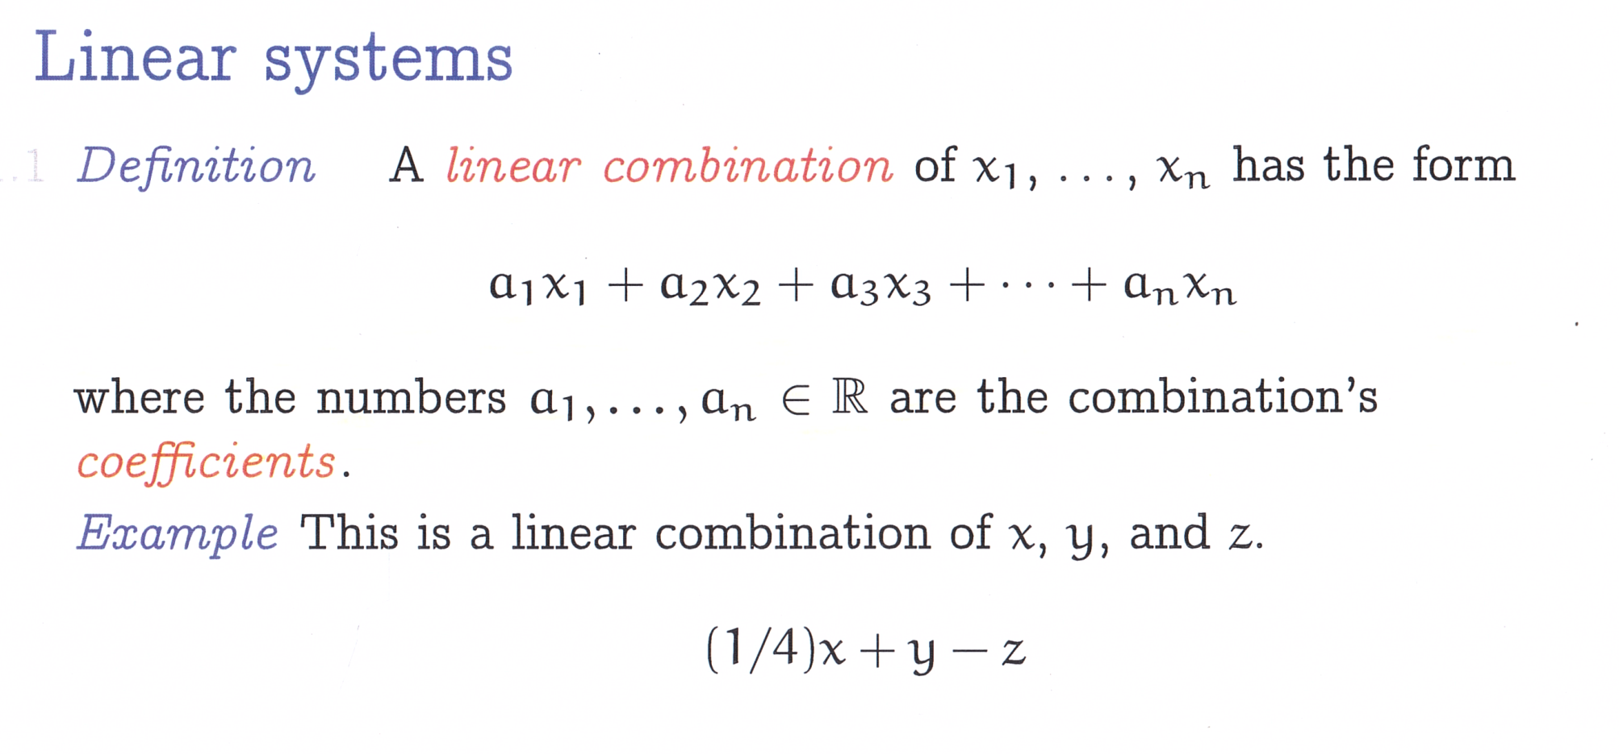
Systems of Linear Equations
Gauss’s Method in Solving Linear Systems

Slide 11
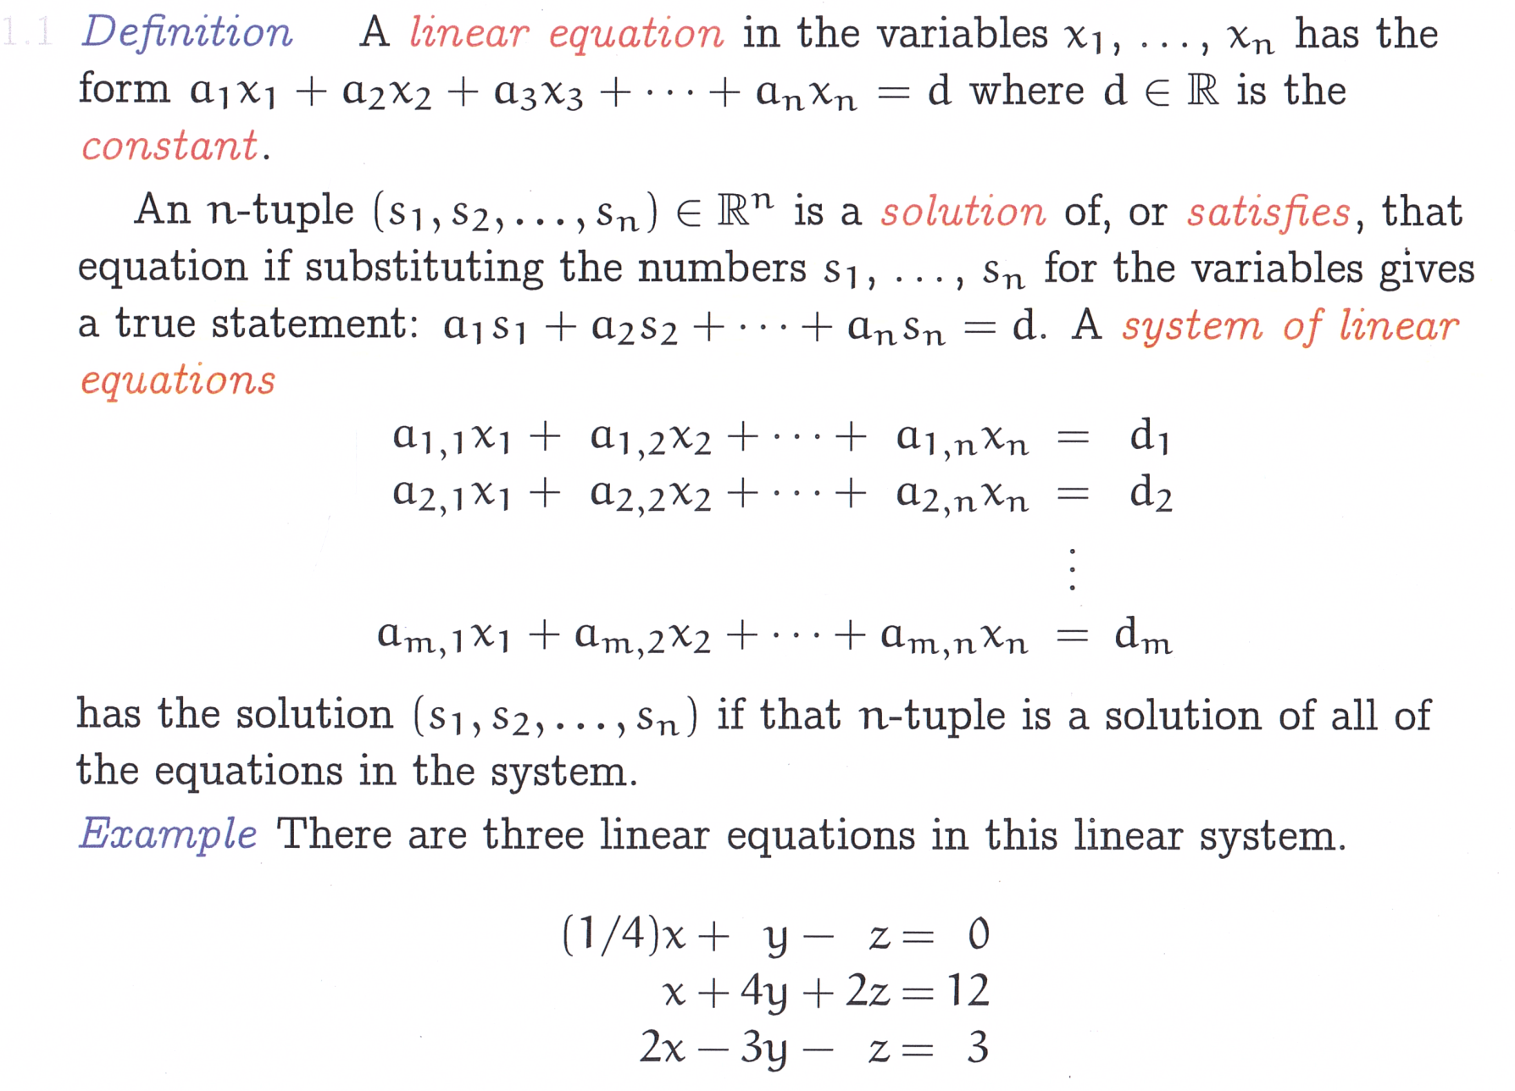
Systems of Linear Equations
Gauss’s Method in Solving Linear Systems

Slide 12
Solving a System of Linear Equations
Solving a System of Linear Equations

Slide 13
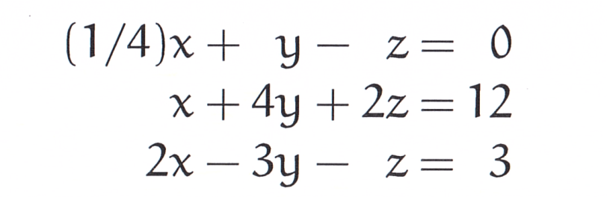
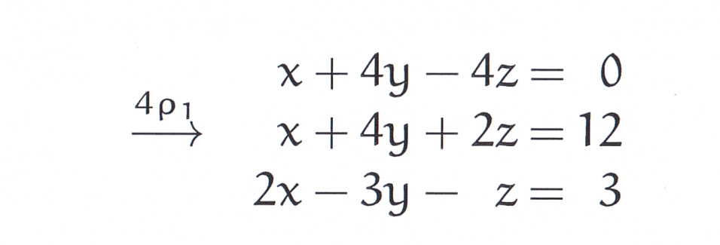
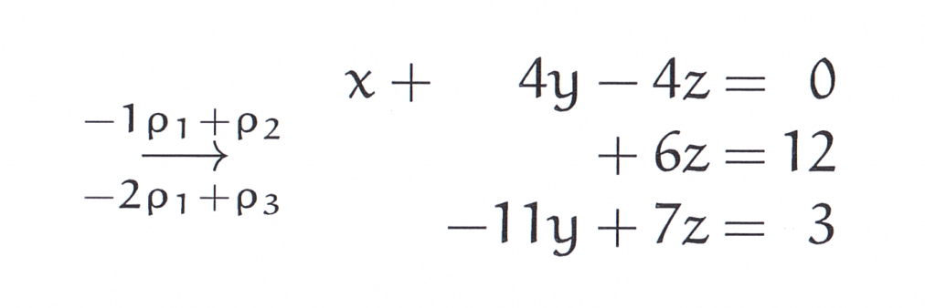
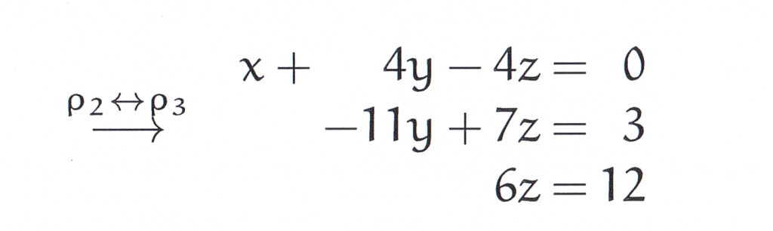
Solving a System of Linear Equations

Slide 14
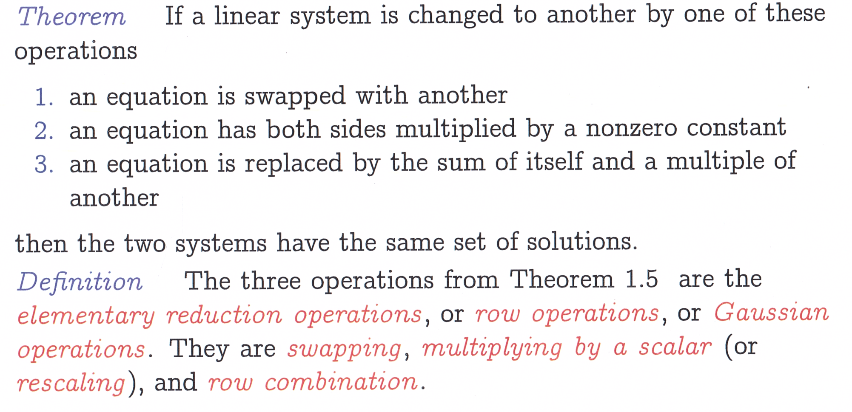
Solving a System of Linear Equations: Gauss Method (year 1803~1809)
Nine Chapters on the Art of Calculation @China , 2000 years ago! Han Dynasty (202BC~9AC)

Slide 15
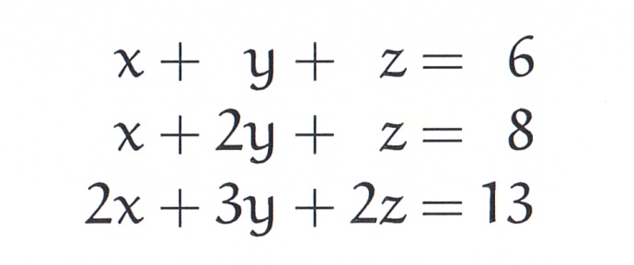
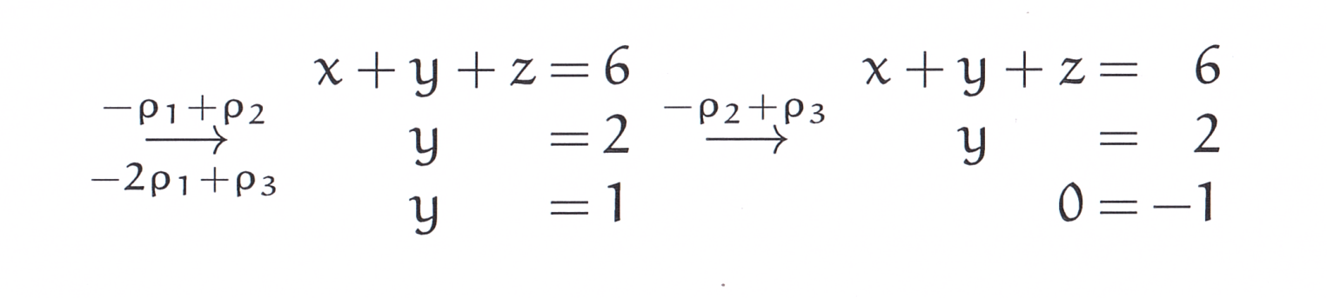
Systems without a unique solution

Slide 16
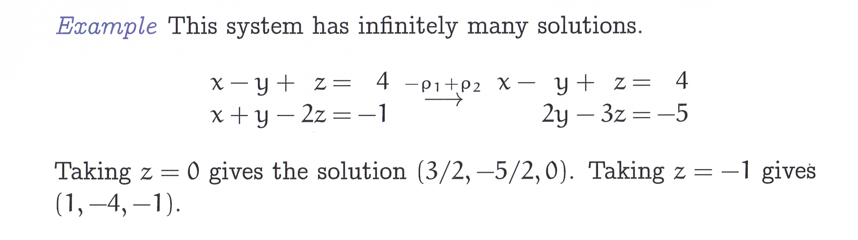
Systems without a unique solution

Slide 17
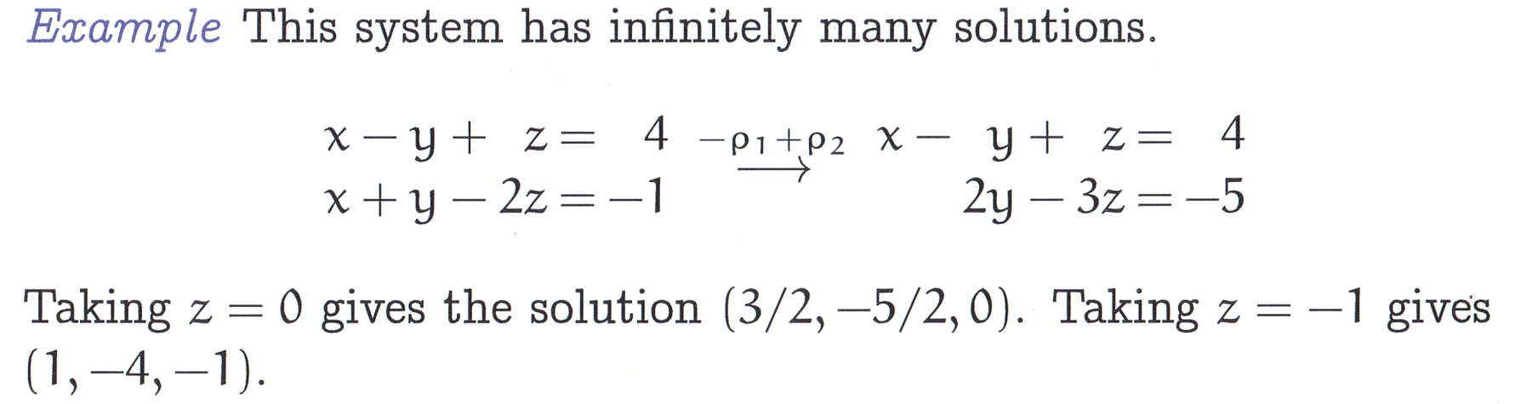
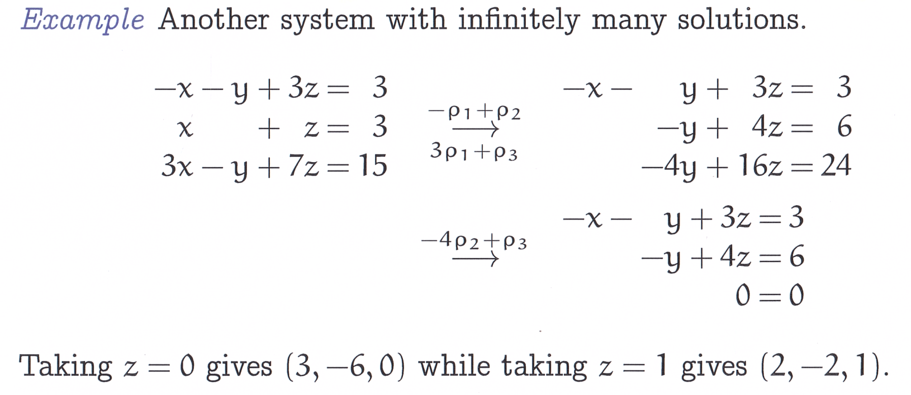
Systems without a unique solution

Slide 18
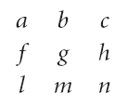
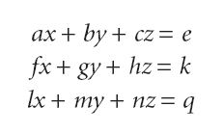
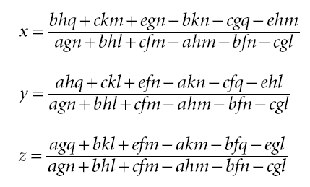
Systems without a unique solution
Cramer’s Method: Japanese Discoverer Takakazu Seki (1642~)

Slide 19
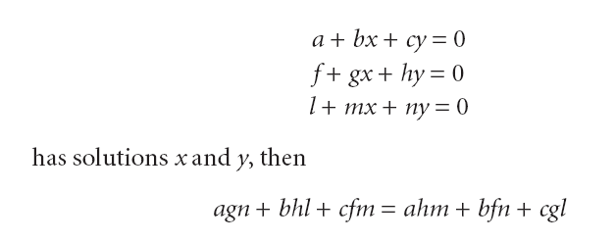
3 Equations and 2 Unknowns, Leibniz at 1683

Slide 20

Q & A

